Slide 1
"A big business starts small"

Slide 2
Gal GKI Group’s founder and President

Slide 3
Agenda
The problem
The idea
Realization
Why us?

Slide 4
The problem
The problem The idea Realization Why us?

Slide 5
The idea
The problem The idea Realization Why us?

Slide 6
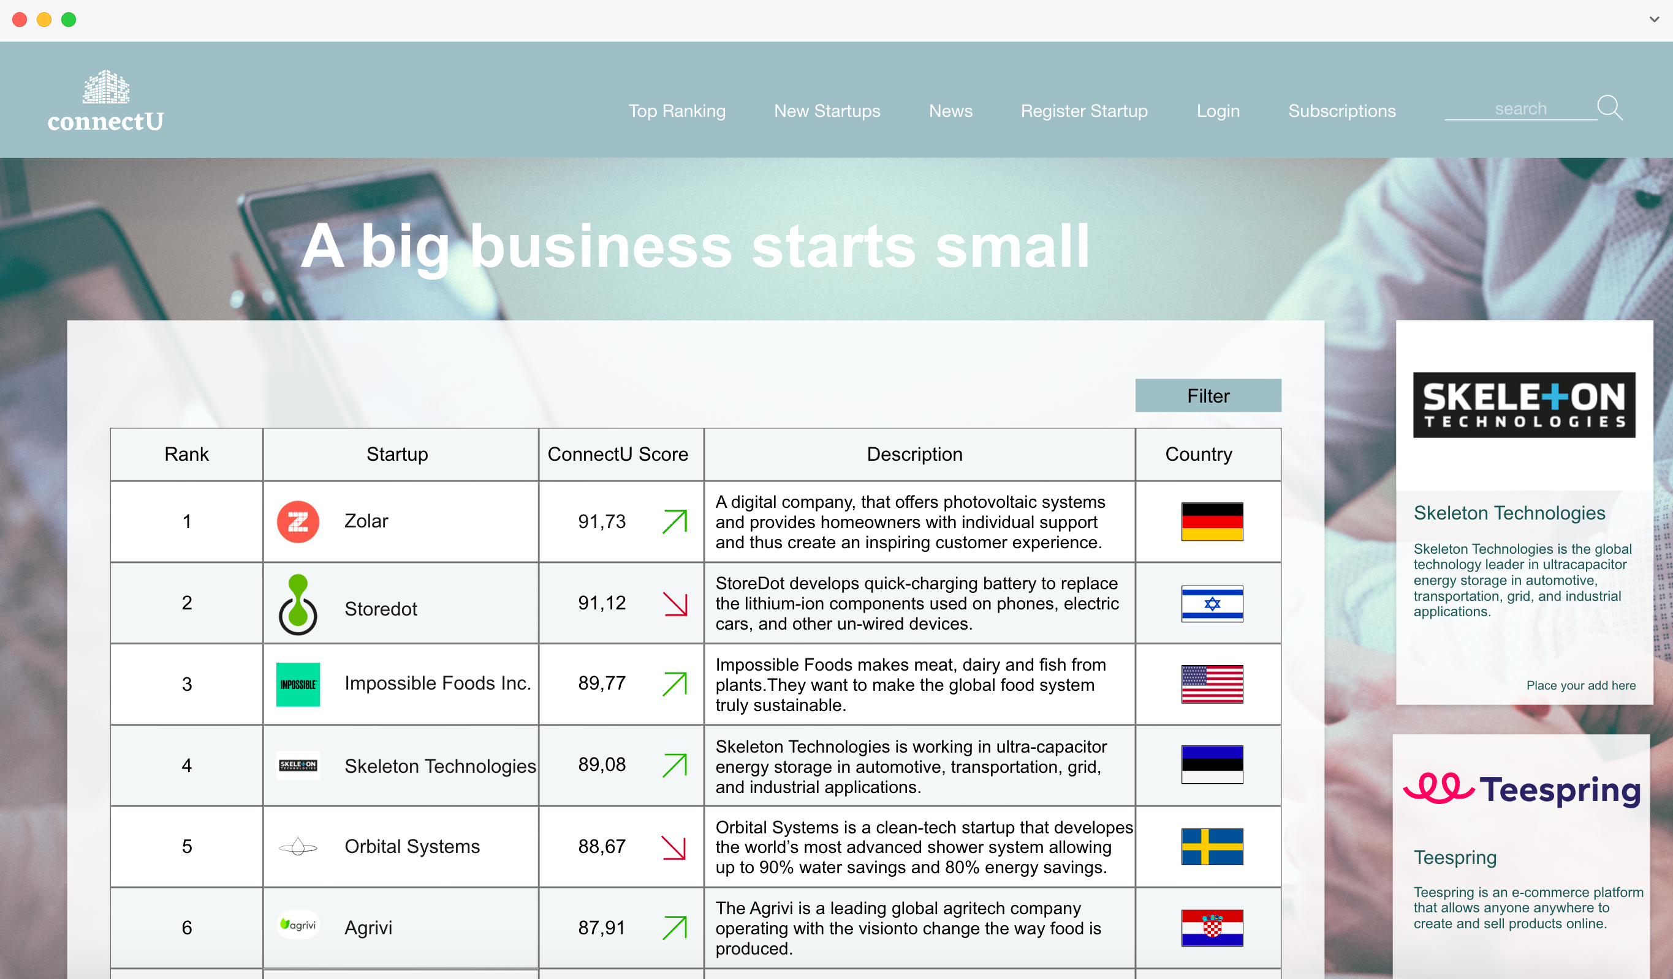
Realization
The problem The idea Realization Why us?

Slide 7
Why us?
The problem The idea Realization Why us?

Slide 8
"A big business starts small"

